Slide 1
Lundi, 27 avril
Le dictionnaire
Learning objective:
To understand how to use a dictionary.

Slide 2
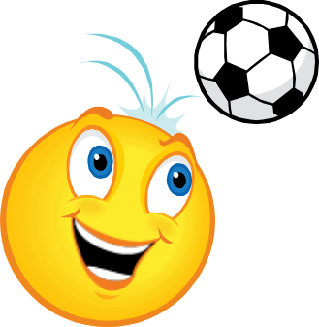
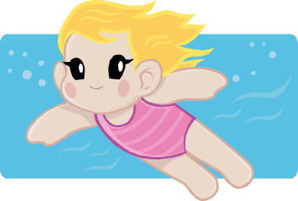
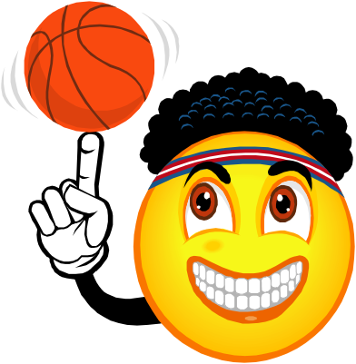
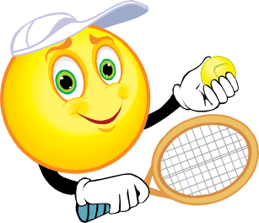
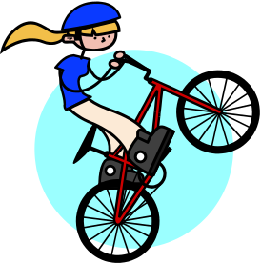

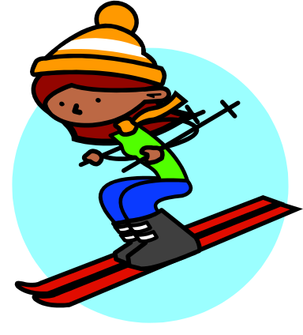
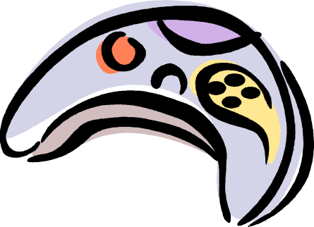

Slide 3

Le dictionnaire
Why use a dictionary?
to look up new words
to check spellings
to find out genders or plurals

Slide 4
How is the dictionary organised?
In two halves, French-to-English and French-to-German
Headwords (in colour) = the words you are looking up
Words at top of page = the first and last entry on each page
Entries in alphabetical order

Slide 5
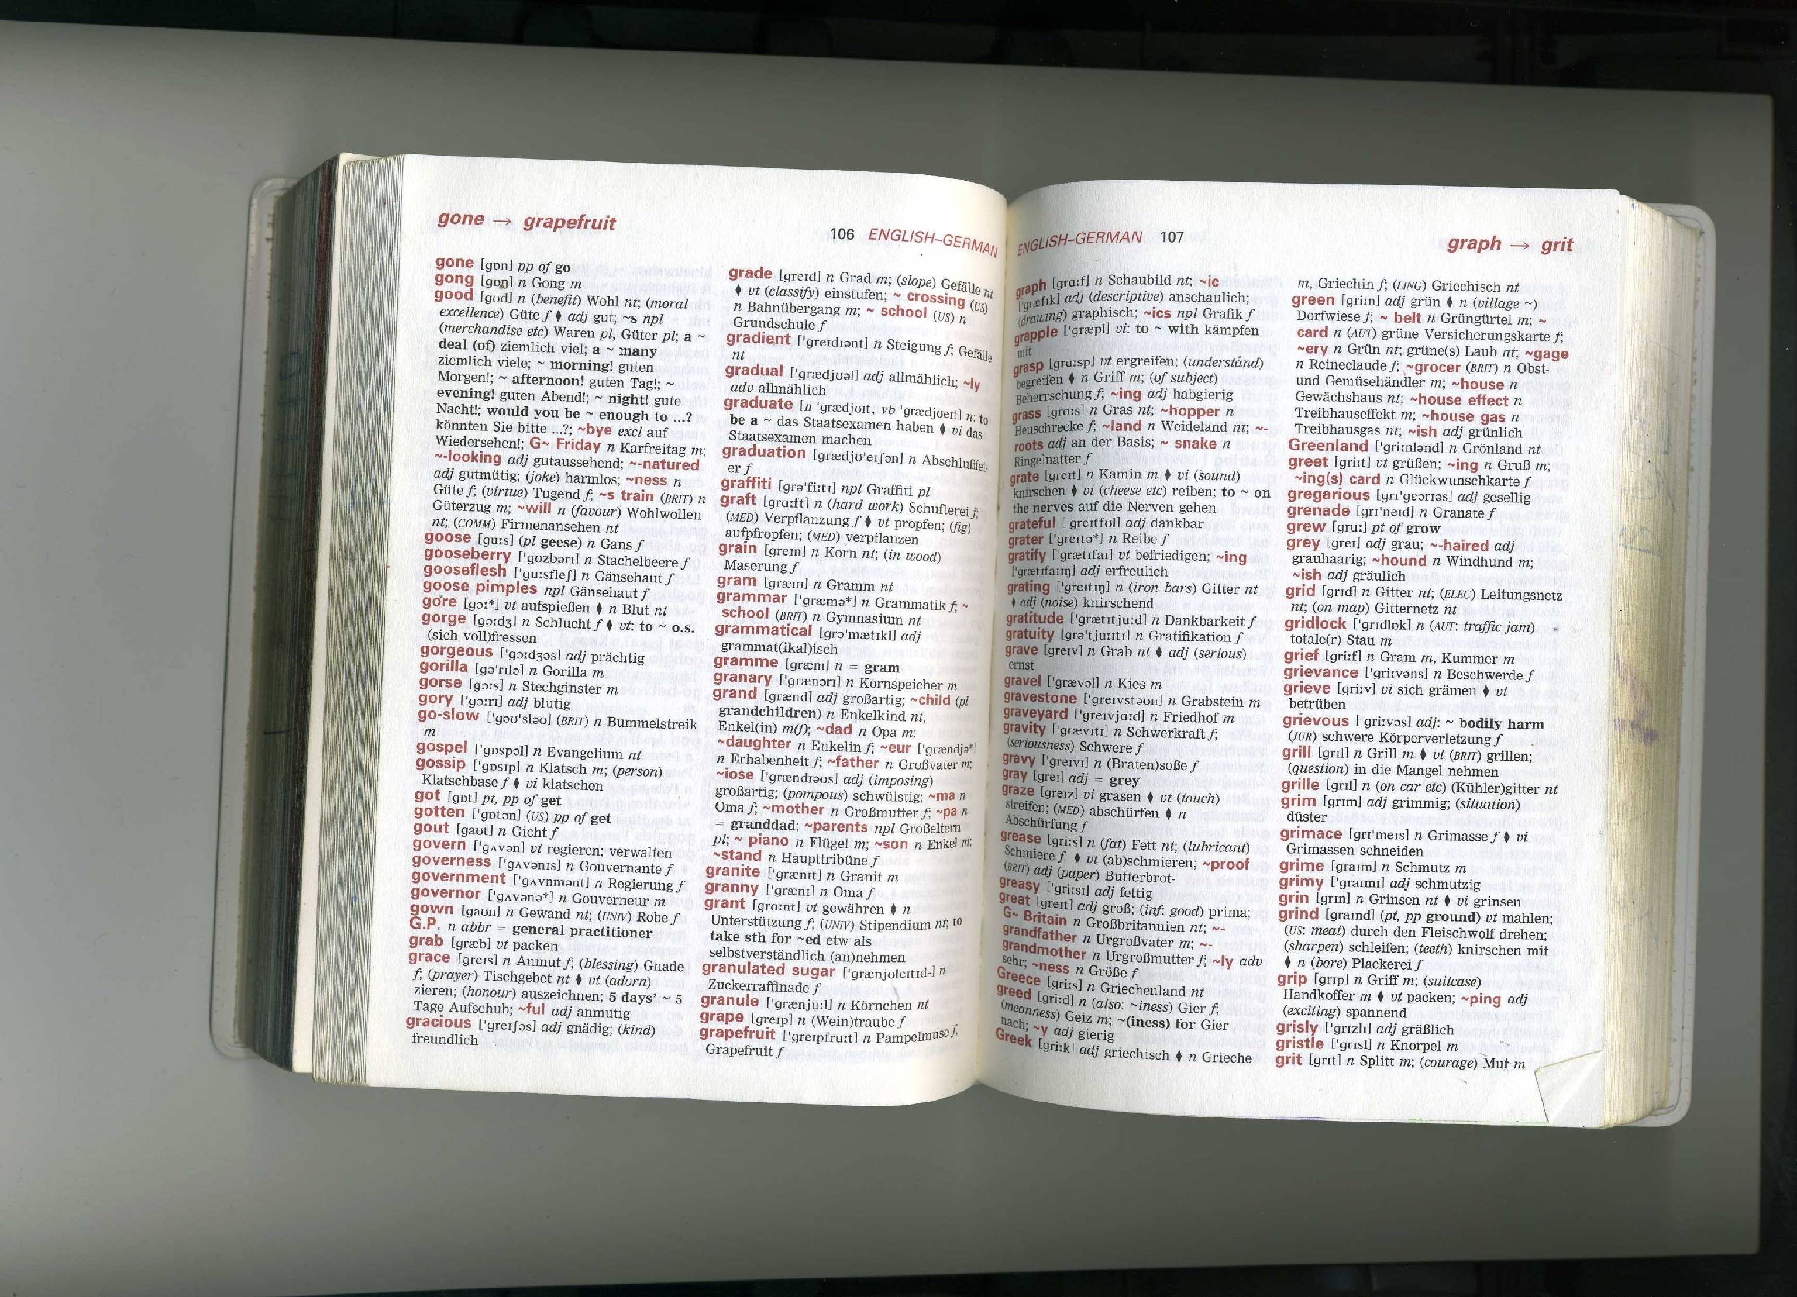

Slide 6
Put the following in alphabetical order
Paris
Lille
Nantes
Le Havre
Perpignan
La Rochelle
Nice
Rouen
La Rochelle
Le Havre
Lille
Nantes
Nice
Paris
Perpignan
Rouen

Slide 7


Write down 6 items of clothing in French
Now look them all up in the French-English part of the dictionary
Time how long it takes you
Did you find them all?
Did you spell them all correctly?
Did it take longer than you expected?

Slide 8
Understanding a dictionary entry
Highlight as you go!
Don’t look up ‘le’ or ‘la’!
Headword vent – the word you wanted
[vã] phonetic spelling, ie. pronunciation
(,) the last bit of this tells us the plural so jupe will become jupe
f = feminine, so it is a la word
() this tells us the context or usage of the word, see Abreviations p.x ( = clothes)
Look for other meanings of jupe
Other abbreviations: n = noun, adj = adjective, vi/vt = verb

Slide 9
Now look up xxx in the French section
You will not always find the word you want as a headword

Slide 10

Have you got the right word?
Look up the English word ‘flier’ (leaflet)
What French word did you find?
Is there more than one?
Which is best?
Now go to the French section and look up dépliant and aviateur to check.
If a word in English has two meanings in French, it is always best to check in the French side too!

Slide 11
Use your dictionary to find the odd one out!
brouillard grêle éclair puce orage
aboyer arroser miauler roucouler ronronner
l'ardoise l'acier le fer le cuivre l'or
le morse la sauterelle l'abeille la guêpe
la mouche

